Slide 1
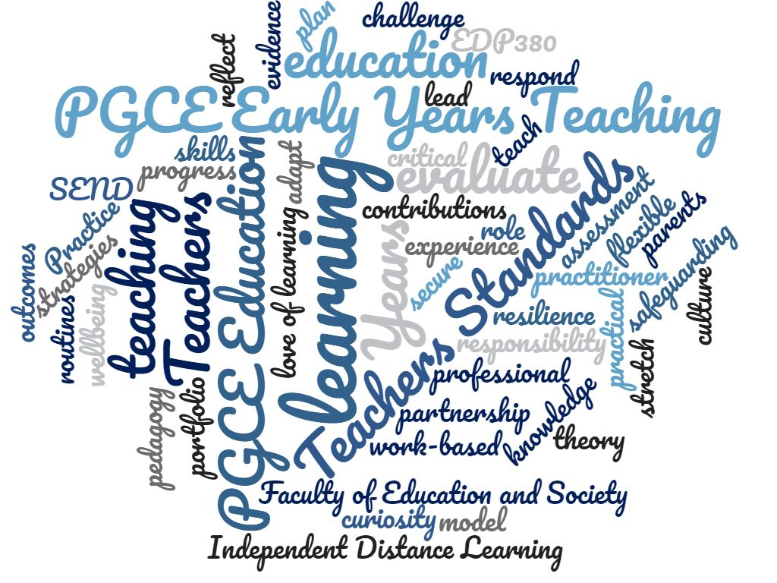
Developing an effective assessment model for the practical element of a teacher training programme delivered via distance learning that promotes reflective practice in trainees.

Slide 2
Background to PGCE Early Years Teaching
Current cohort information
Hong Kong – 28
China – 8
Thailand - 4
Qatar – 3
Dubai – 3
Norway – 2
Bahrain – 1
Egypt – 1
Korea – 1
Switzerland – 1
Uganda – 1
Italy – 1
Sweden – 1
UK – 1
Japan – 1
Australia – 1
Theory – programme content
Support – mentor & University
Effective, reflective trainee
Trainee ethos and principles

Slide 3
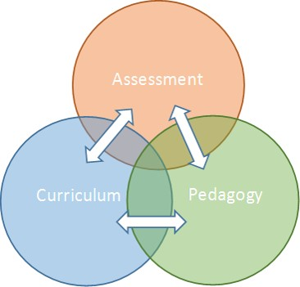
Objective of the Research
Increased validity within module
Students currently driven by summative assessment, encourage a culture change to move to a more learner centred environment
Move away from assessment of learning and move towards assessment for learning

Slide 4
Hypothesis
Enriched reflective practice
More meaningful dialogic exchanges
Effective engagement from in-school mentors

Slide 5
Research Design
‘There is a concern for processes rather than simply with outcomes.’
Cohen, Manion & Morrison, 2011
Action research
Interpretivist paradigm
Internal validity

Slide 6
Consideration of Variables:
Trainees’ perception of assessment
Prior existing experience of teaching
Level of support provided
Quality assurance
Autonomy in identifying targets
Logistics of academic work loading
Layers of Support
In-school mentor
Personal Academic Tutor
Programme Level

Slide 7
Research Methods
Disconnect identified between theory and practice
Review existing module content and assessment method
Audit of module content
Presented suggested adaptations to wider IDL team
Pilot of dialogic assessment
Questionnaires
Roll out to current cohort – next cycle
‘Subjectivity is not seen…as a failing, something to be eliminated, but as an essential element of understanding human activity.’
Stake, 2010

Slide 8
Moving Forward
‘Overload in terms of document requirements…’
‘Too much paperwork to submit…completely overwhelming and took away any enjoyment from the module.’
‘… so many documents required that the focus became filling in all documents rather then focusing on the teaching practice!’
‘Be prepared for the volume of documentation – it nearly killed me!’
Sept 2019 Trainee feedback for EDP380
Feedback gathered around existing assessment model
Audit of existing best practice
Audit of modules within programme
Revised and developed module documentation
Pilot dialogic assessment
Review and gather data from formative assessment
Continuous development of community of learning
‘As someone that has been part of two separate IDL cohorts through Sunderland, I have been able to experience first hand the difference of approach when comparing the two. This cohort has felt much more inclusive, open and personal from the get go...genuine approachable teachers… from looking at the discussion boards on canvas this year and viewing the amount of keen responses, peer assistance and sharing of ideas from student-student in this cohort, I think you can tell that this openness has become infectious.’
April 2020 Trainee (Returner from LOA from September 2019 cohort)

Slide 9
Cohen, L., Manion, L. & Morrison, K. (2011) Research Methods in Education. 7th edn. Routledge: London.
Denscombe, M. (2010) The Good Research Guide for Small-scale Social Research Projects. 4th edn. Maidenhead: Open University Press
Gregson, M, Hillier, Y, Biesta, G, Duncan, S, Nixon, L, Spedding, T and Wakeling, P (2015) Reflective Teaching in Further, Adult and Vocational Education. UK: Bloomsbury
Mehdi, F and Mahdi, T (2018) Effectiveness of teaching methods in business education: A comparison study on the learning outcomes of lectures, case studies and simulations. International journal of management education, March 2018, vol 16, Issue 1, p131-142
Sambell, K, McDowell, L and Montgomery, C (2013) Assessment for Learning in Higher Education. Oxon: Routledge
Schon, D. (1987) Education the Reflective Practitioner. San Francisco: The Jossey-Bass higher education series
Stake, R.E. (2010) Qualitative Research: Studying How Things Work. New York: The Guilford Press
Thank you for your time.
Any questions?

